Slide 1
Guiding Principles
This event is meant for the pleasure of members of the HQ SACT Officers’ Mess and their guests. Members are permitted a partner and one guest couple at reduced price. Additional guests may be invited at full price ($110 per person). This is an adult affair, no persons under 21 years of age are permitted.
Non-members are permitted to attend at the sole discretion of the event organisers. Persons who are eligible to be regular members but choose not to become members are not allowed as guests.
There is a formal dress code that will be strictly enforced. Male officers should wear mess dress and other gentlemen must wear tuxedo. Female officers may wear either mess dress or ball gown and other ladies must wear ball gown. You must reserve a seat at www.officersmess.us and properly identify each person in your party. Proper identification is required for security purposes. There is a maximum sign up of 300 for this event. If you have issues, contact Wayne at buck@act.nato.int. Only Wayne can deal with attendance issues.
A professional photographer is employed for the event and all photographs may be used for future marketing purposes without prior permission of attendees.
2019 Buck-Hart Productions
HQ SACT Officers’ Mess
Presents
The
Valentine’s Ball
Friday, 8 February 2019
The Westin
4535 Commerce Street
Virginia Beach, Virginia 23462

Slide 2
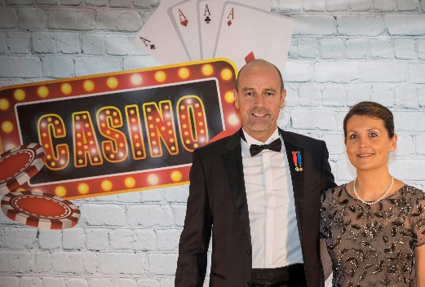
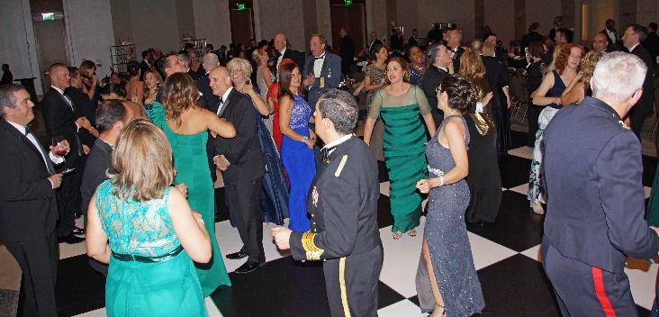
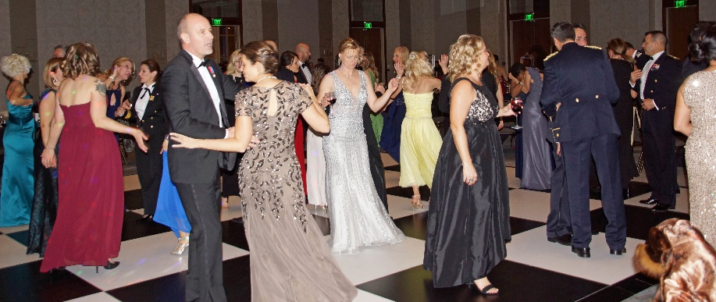
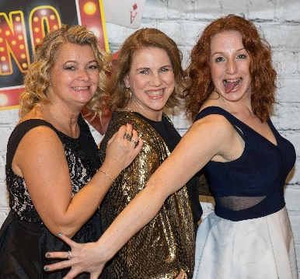
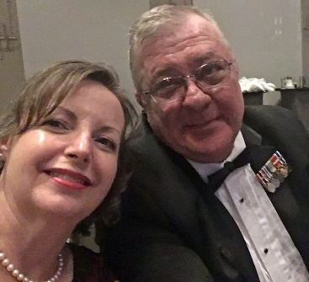
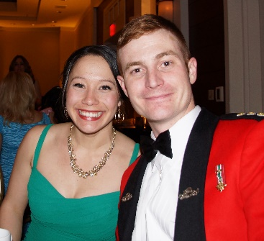
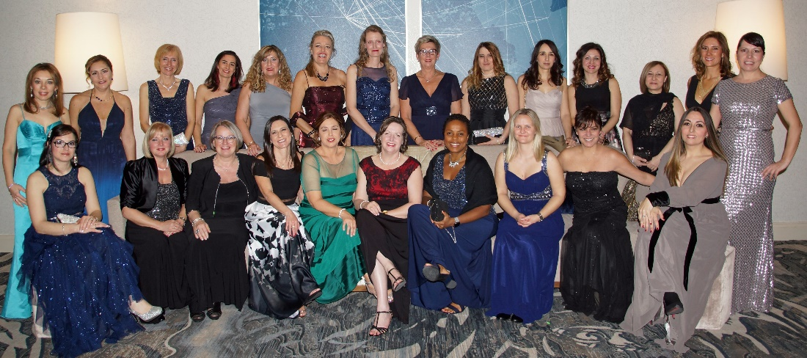
The
Valentine’s Ball
Presented By
HQ SACT Officers’ Mess
8 February 2019, 1900-2400 hours
The Westin
4535 Commerce Street
Virginia Beach, Virginia 23462
$49.99 per person Price Includes:
3 Course Meal with Selection of
Beef, Chicken or Vegetarian
Free Drinks from 1900 to 2000 hrs
Mix of Red and White Wine on Table
Local Mixed Music Band
Portrait Photographer
REALLY Nice Favours
Military - Mess Dress
Civilian – Tuxedo (Black Tie) or Long Gown
( -> a business suit is not a tuxedo <- )
$49.99 Per Person. See Guidelines on Back.
Registration begins on 2 January 2019
www.officersmess.us

