Slide 1
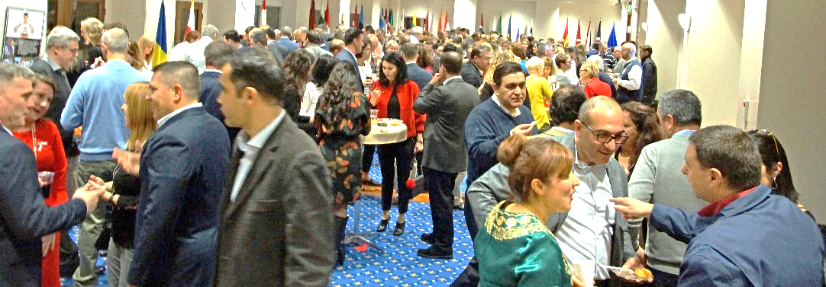
Guiding Principles
This event is meant for the pleasure of members of the HQ SACT Officers’ Mess and the SOPC. Members are permitted a partner and one guest couple. This is an adult affair, no persons under 21 years of age are permitted due to liquor license regulations.
Non-members are permitted to attend at the sole discretion of the event organisers. Persons who are eligible to be regular Mess or SOPC members but choose not to become members are not allowed as guests.
The dress is smart casual. You must reserve a ticket at www.officersmess.us and properly identify each person in your party. Proper identification is required for security purposes. There is a maximum sign up of 250. ISRM spouses should contact chairperson@sopc.us for details on how to register.
If you have issues, contact Wayne at buck@act.nato.int. Only Wayne can deal with attendance issues.
A professional photographer is employed for the event and all photographs may be used for future marketing purposes without prior permission of attendees.
2022 Buck-Hart Productions
HQ SACT Officers’ Mess
and the SOPC
present
7th Annual
International
Food Night
Friday, 20 May 2022
HQ SACT Dining Room
Naval Support Activity Norfolk

Slide 2
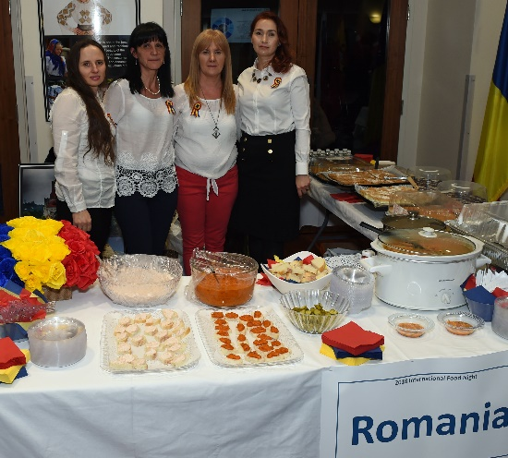
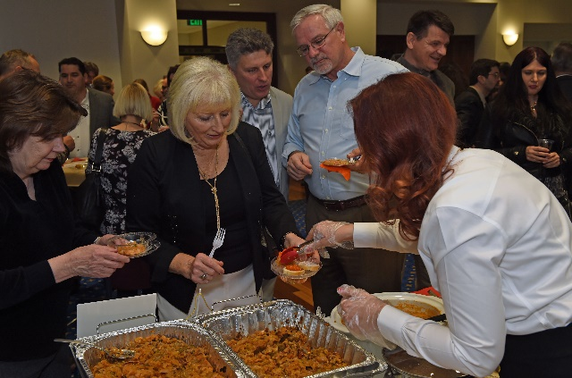
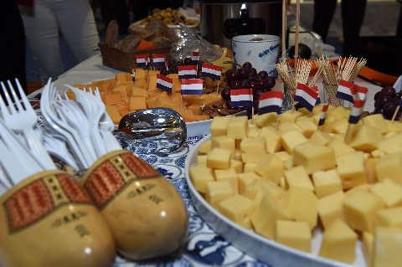
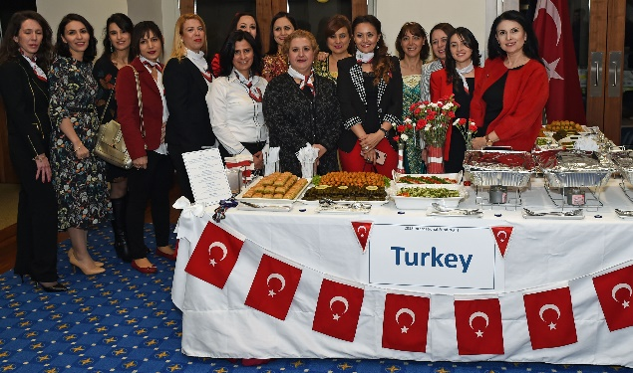
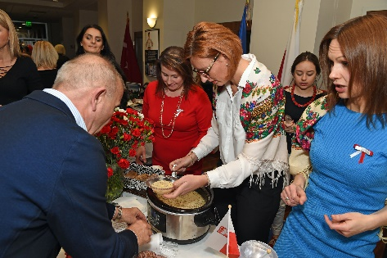
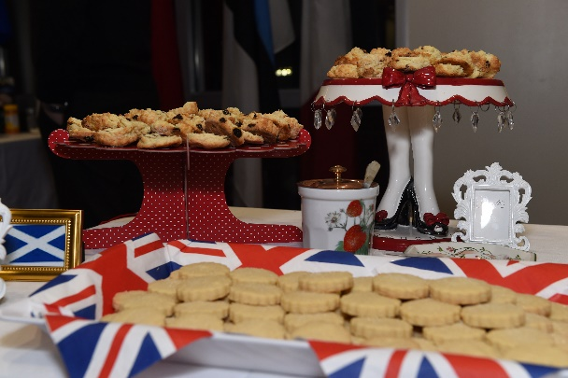
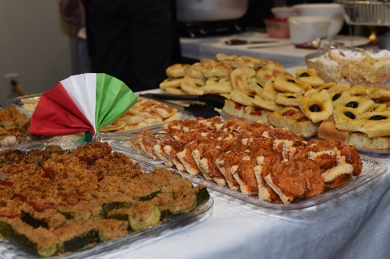
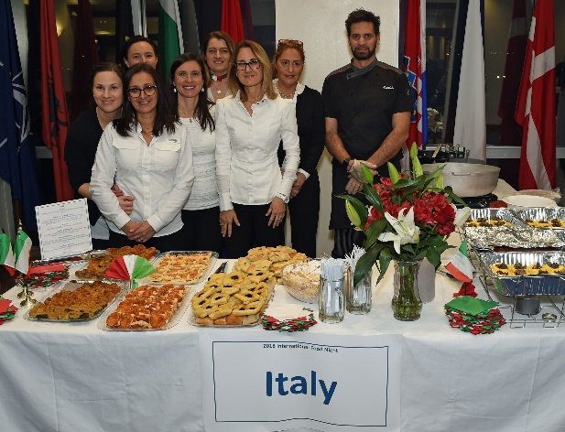
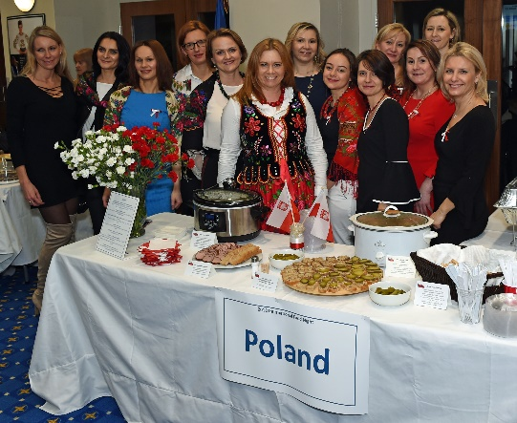
International Food Night
Ticket Price is $10 per person
(includes entry, food samples, one glass
of wine, or soft drinks / water plus
$3 coupon for Red Barn on $25 order)
20 May 2022, 1830-2130 hrs
HQ SACT Dining Room
Register at www.officersmess.us
Sign up starts 18 April 2022
Registration Closes on 19 May 2022
Or When Limit is Reached
Smart Casual, No Jeans
2012
Canada
Estonia
Italy
Romania
Spain
United Kingdom
2013
Albania
Belgium
France
Greece
Netherlands
Poland
2014
Bulgaria
Czech
Republic
Denmark
Hungary
Portugal
Slovenia
Slovakia
2022
Belgium
France
Germany
Turkey
United Kingdom
United States
2018
Italy
Netherlands
Poland
Romania
United Kingdom
Turkey
2019
Canada
Croatia
France
Germany
Greece
Norway
Slovenia
2020
Czech
Republic
Denmark
Spain
Italy
Poland
Portugal

